Slide 1
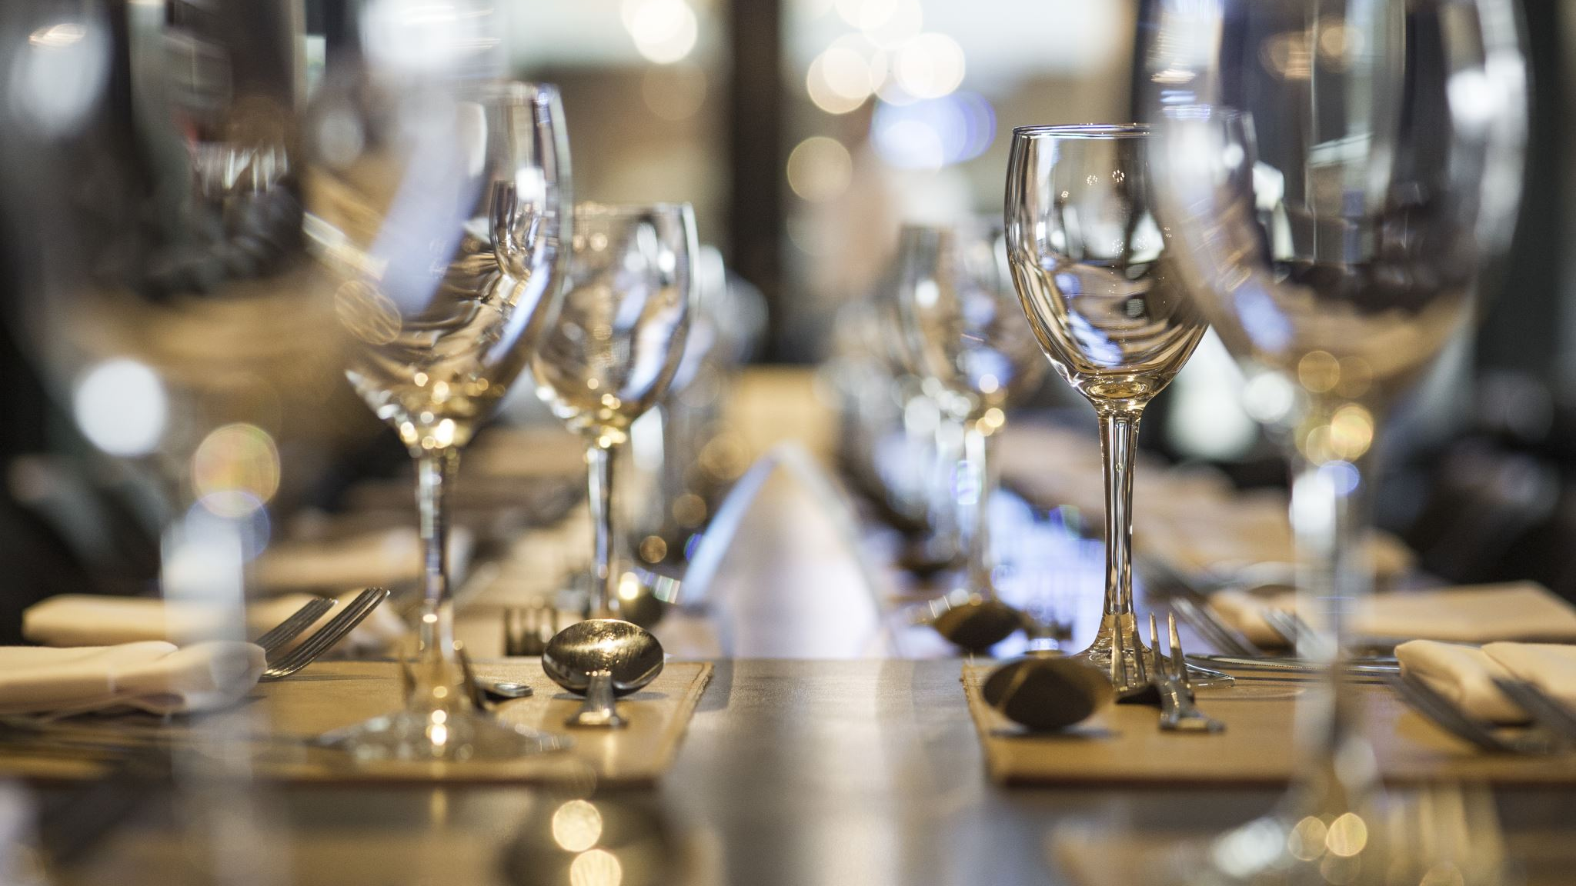
Waiter Tips prediction
A Suraj Reddy- AM.EN.U4CSE20012
ASK Viswas- AM.EN.U4CSE20013
N Sai Sandeep- AM.EN.U4CSE20049
P Laxmi Praneeth- AM.EN.U4CSE20052
CGS Pranav Advaith- AM.EN.U4CSE20056

Slide 2
INTRODUCTION
In this project we will predict tips given to a waiter for his/her service.
Task (T): Analyzing and predicting the tips for a waiter.
Experience (E): A collection of various data sets that include some attribute related to the waiter, services, total bill, smoker, time etc.
Performance (P): The number of successful predictions made out of the total number of requests received from the client.

Slide 3
MOTIVATION
Giving a waiter or waitress a tip does a lot for them. You are signalling to them that you appreciate them and want to give something back. Their hard work makes your experience at the restaurant more enjoyable, So, this machine learning model will help in predicting the tip for the waiter.
Model Use: This model predicts the tips for the waiters. So, if we give a proper prediction of tips for waiter and improve their services.

Slide 4
DATASETS
https://www.kaggle.com/datasets/aminizahra/tips-dataset
https://www.kaggle.com/datasets/rupakroy/waiter-tips-dataset-for-prediction
https://raw.githubusercontent.com/amankharwal/Website-data/master/tips.csv
The dataset contains attributes total_bill, tip, sex, smoker, day,time, size,price_per_person,payer name, cc number
The above-mentioned data sets predict about the waiters' tips according to their services. This can be predicted by total bill, tip, smoker, time, price per person and may contain information about customers

Slide 5
Data Pre processing
We want to predict the tip from other columns therefore we have to scale the numerical columns and encode categorical columns. For binary ones we have to either use label encoding or one hot encode them, then drop duplicate ones.
Now all of our attributes contains numerical values only.
Visualize the data using various plots like scatter plot, histograms, box plot etc and record your interpretations with varying values.

Slide 6
LEARNING ALGORITHMS
Linear Regression
Support Vector Machine
KNN
Random Forest Regressor

Slide 7

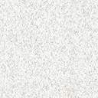
Linear Regression
Linear regression is one of the easiest and most popular Machine Learning algorithms. It is a statistical method that is used for predictive analysis. Linear regression makes predictions for continuous/real or numeric variables.
The linear regression model provides a sloped straight line representing the relationship between the variables.
Mathematically, we can represent a linear regression as:
y= a₀+a₁x+ ε

Slide 8
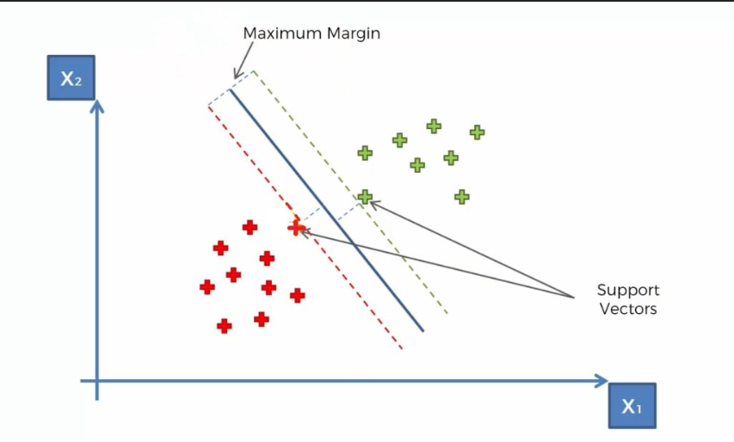
Support Vector Machine
Support Vector Machine or SVM is one of the most popular Supervised Learning algorithms, which is used for Classification as well as Regression problems.
The SVM regression algorithm is referred to as Support Vector Regression or SVR.
The goal of the SVM algorithm is to create the best line or decision boundary that can segregate n-dimensional space into classes so that we can easily put the new data point in the correct category in the future.

Slide 9
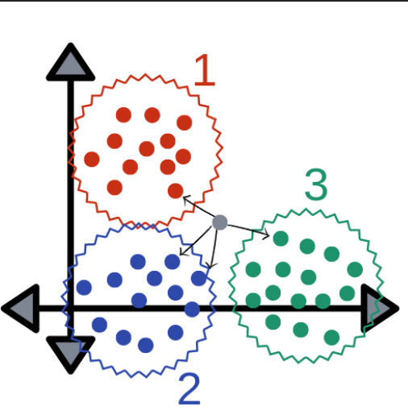
K Nearest Neighbour
K-Nearest Neighbour is one of the simplest Machine Learning algorithms based on Supervised Learning technique.
K-NN algorithm stores all the available data and classifies a new data point based on the similarity. This means when new data appears then it can be easily classified into a well suite category by using K- NN algorithm.
K-NN algorithm can be used for Regression as well as for Classification but mostly it is used for the Classification problems.
K-NN is a non-parametric algorithm, which means it does not make any assumption on underlying data.

Slide 10
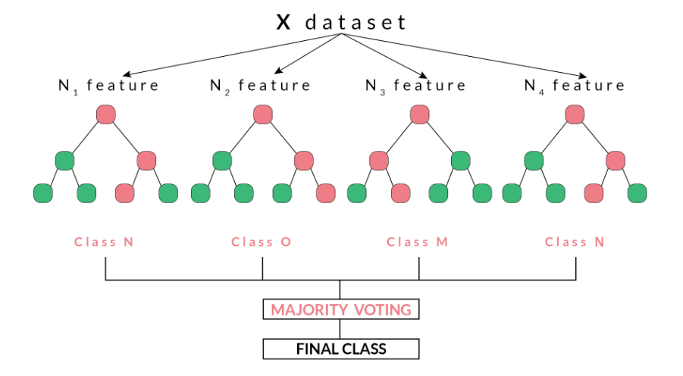
Random Forest Regressor
A random forest is a machine learning technique that's used to solve regression and classification problems. It utilizes ensemble learning, which is a technique that combines many classifiers to provide solutions to complex problems.
A random forest algorithm consists of many decision trees. The random forest is a classification algorithm consisting of many decisions trees. It uses bagging and feature randomness when building each individual tree to try to create an uncorrelated forest of trees whose prediction by committee is more accurate than that of any individual tree.

Slide 11
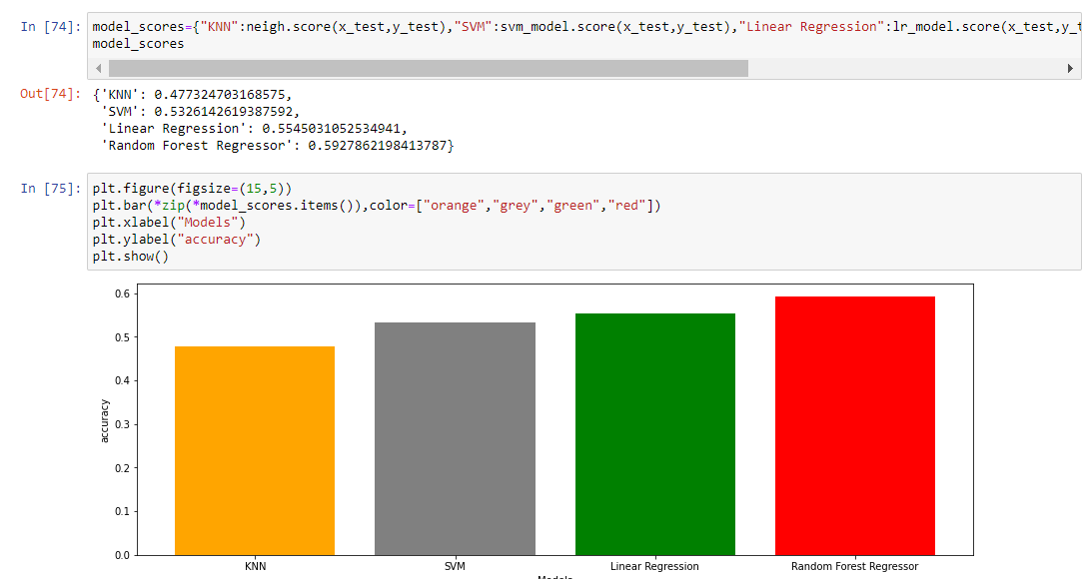
Results and Analysis
Accuracy for Random Forest Regressor is high among all the models. So we will use Random Forest Regressor for prediction.
We also found out the errors in each of the models and choose the model which gives the least error.

Slide 12
CONCLUSION
We generated a Machine Learning model by using Random Forest Regressor from which we can predict the tip given to the waiter based on six features.
In future, the designed system with the used machine learning regression algorithms can be used to predict the tips of a waiter. The work can be extended and improved for the automation of waiters tip analysis including some other machine learning algorithms.

